Slide 1
In this newsletter?
Results from the weekend of Saturday 11th October 2025
Dates for the Diary:.
OWFC VPs day – Saturday 18th October 2025
Other Bits
Men Of The Hill
All Our yesterdays (25/ 50 years Ago)
Monday night Training @ Coloma School, Shirley, 8pm until 9.30 on their 3G pitch with a UEFA B Qualified Coach. Cost is £5
OWFC Code of Conduct and Annual Subs Update
Team of the Week
Fixtures for next weekend
OWFC Togger (Contact Roddy Trompiz, OWFCtogger@outlook.com)

Slide 2


Slide 3
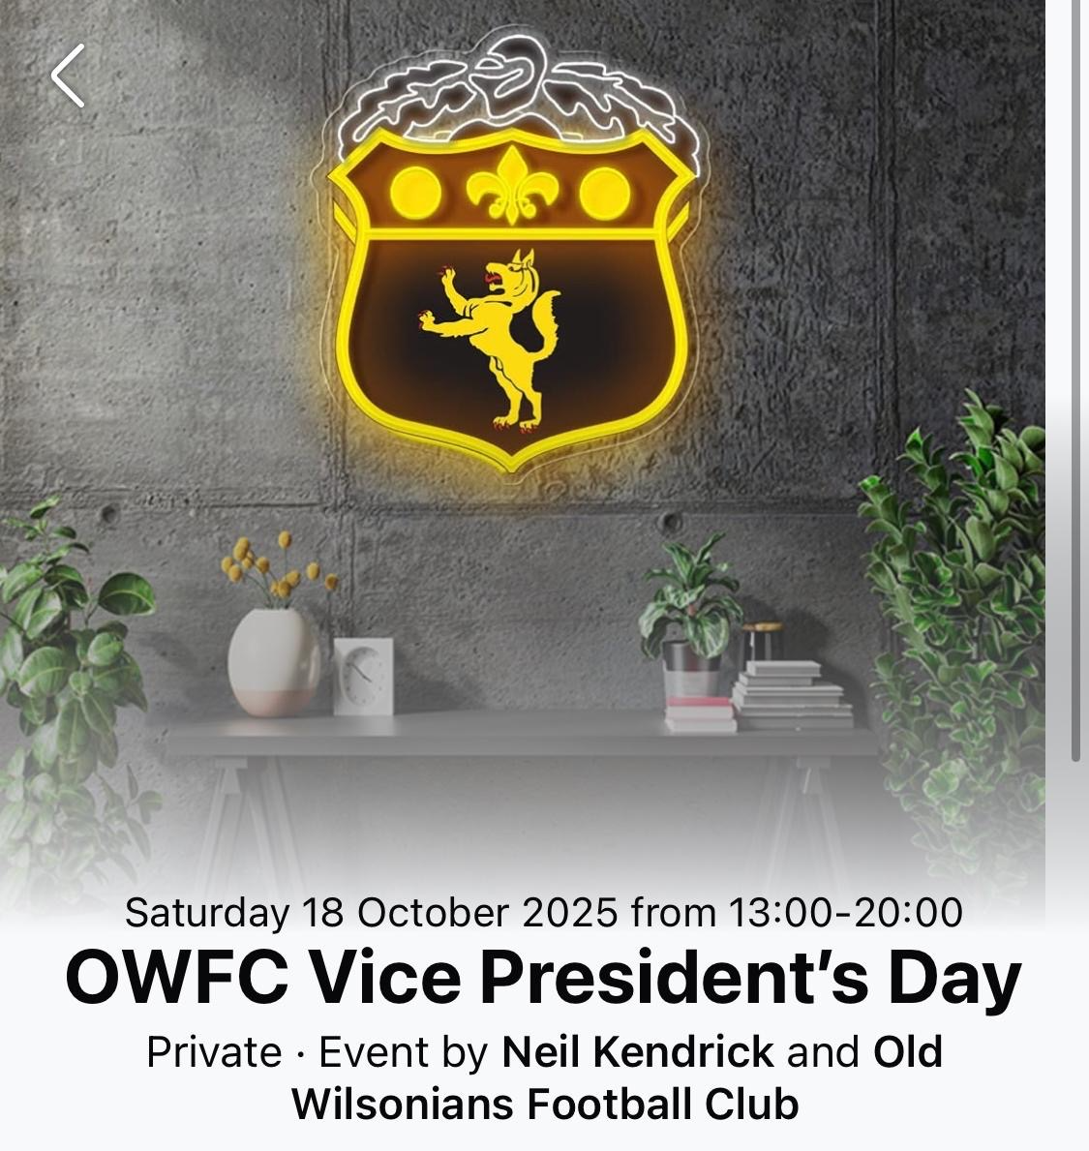

Slide 4
** OWFC TEAM OF THE WEEK, WEEKEND OF 11 OCTOBER 2025 **
Whetton (4th XI)
Ed McLaughlin (Vets)
Nathan Carter (6th XI)
Calum Sutherland (2nd XI)
Jordan Richards (6th XI)
Ollie Sitch (1st XI)
Jack Curtis (7th XI)
Sam Forbes (2nd XI)
Josh Buddle-Smith (2nd XI)
Sam Wright (1st XI)

Slide 5
OWFC Business Code of Conduct / Annual Subs
A new season is upon us . With a further influx of juniors and schoolboys , plus training and a couple of teams playing through the summer. Our hopes are high. We have 7 teams on
Saturday & the Vets on Sundays playing league football . Supervets will continue to play friendlies on Sundays.
We have kept annual subs for 21s & over in employment to £150 & under 21s in employment £75, both pay £10 weekly subs . If you are playing 4 or less games you will pay £20 match fees , but no annual subs. Junior members paying annual subs to the junior section & schoolboys pay no annual subs but pay £5 weekly subs. Vets due to the number of games pay annual subs , Supervets pay £50 annual subs & £10 per game match .
Unemployed please chat to your skipper or Stu Dunk (treasurer or me (asst treasurer) and we will agree something that is workable for you as we want you to play . Annual subs are due on 30th September 2025 . We are using Pitchero & you should have an email to confirm your details, receive newsletters , about events also paying your annual subs or outstanding fines like yellow and red cards.

Slide 6
Why the rise in annual subs ? our rent to the association has gone up by 7.5% this season taking it above £24,000 per annum . The reason is ground maintenance (looking after both hayes & Hawesdown) costs £71,000 per year (up from £60,000 last season due mainly to the extra cost of running Hawesdown), utilities has gone from £21,000 in 2021 to over £54,000 in 2025. So it is important you pay your annual subs on time as we look to break even. Its also important you support events not only so you meet players from other teams but also have some fun & hopefully we make a bit of money , which will hopefully keep your annual subs as low as possible Also find a code of conduct we expect all our member to follow. Please read them as this is the minimum we expect as a club. Here's to a great season , good luck & enjoy
Alex Forbes OWFC Assistant treasurer

Slide 7
Old Wilsonians Football Club
Code of Conduct
As a representative of the Old Wilsonians Football Club, I agree that;
On and off the pitch, I will:
• Always play the game fairly and in the right spirit.
• Be aware of the impact of bad language; keep spectators and members of the public - including children - in mind.
• Never verbally abuse a match official, player or spectator based their appearance, race, religion, gender or sexuality. Doing so could lead to dismissal from the field, suspension and possible police action.
• Never physically assault a match official, player or spectator. Doing so could lead to dismissal from the field, suspension and possible police action.
• Help to create a safe and inclusive environment both on and off the pitch.
• Report all allegations of abuse or poor practice to the Club Welfare Officer.
• Not to abuse, neglect, harm or discriminate against anyone; or act in a way that may be interpreted as such.
• Adhere to the club’s safeguarding policy, rules and regulations.
• Attend the match with correct kit, this includes black shorts and gold socks.
• Arrive on time. If for any reason I may be late, I will inform my captain as soon as possible.
• Respect the decisions made by my captain.
• Not drop out from the game at short notice. This is unfair to other players who may have been left out, so that I could play. If I have a valid reason, I will inform my captain. Failure to contact my captain will result in being reported to the disciplinary committee.

Slide 8
Old Wilsonians Football Club
Code of Conduct continued
Selection, finances and expected conduct.
• I understand, if I have made myself available to play, I will be expected to represent any team within the Old Wilsonians football club, as per rule 11 of the OWFC rules.
• I will sign up to the FA Matchday app.
• I will pay my annual and weekly subs on time. If I am unable to do this, I will inform the club treasurer who may be able to assist.
• I will conduct myself in such a manner as not to bring the Old Wilsonians football club into disrepute.
• I will not be involved with/under the influence of any drugs or illegal substances whilst representing the football club, in line with the OWFC drugs policy.
• When playing at home, I will help when required to offer hospitality to the visiting teams and complete requested duties.
• I understand the expectation that I support the club with fundraising events and activities.
• I understand that I need to provide the club with any personal data required for registration and/or safeguarding purposes.
• I will refrain from any criminal activity. I will represent the club with integrity and honesty.

Slide 9
Old Wilsonians Football Club
Code of Conduct continued
I understand: If I do not follow the Code, I may expect to:
• Be cautioned, sin binned or sent off by the match officials, depending on the nature of the offence.
• Be asked to apologize to whoever I have offended or abused.
• Be disciplined by my club via the disciplinary committee, including being substituted, dropped, given a formal warning, suspended from training or matches or a permanent suspension from the club. This will depend on the nature of the offence.
• Be disciplined by the County Football Association, including being fined or suspended for a number of matches depending on the nature of the offence.
• Be handed a permanent exclusion by the FA or County Football Association if the offence is deemed serious enough. Declaration: I agree to abide by the conditions above and follow any guidance or policy as set out by Old Wilsonians football club, The AFA (County FA) or the Football Association.

Slide 10
Join the 100 club today . All funds are sloughed back into the club, so any support is appreciated. Also, if you are a gold member you get £50 back to spend across the club ie you could use it for annual subs
It's easy to enter follow the details below
There are 3 levels to the 100 club :-
If you pay one lump sum you get 2 months for free !
Gold £25 per month or one off £250 per year. For this u get £50 off annual subs or can be spent within the club on merchandising or events
Silver £10 per month or one off £100 per annum
Bronze £5 per month or one off £50
15 draws a year . one number across all 3 colours . Drawn monthly with one of the big 3 every 4 months
Prizes
Gold top prize 1 x £5000 , 2 x £2500 and 12 x £500
Silver top prize 1 x £2000, 2 x £1000 & 12 x £200
Bronze top price 1 x £1000, 2 x £500 & 12 x £100
We would love you to participate .Let me know what you have picked which colour works for you ( if any) and I will let u know your lucky number - alexforbes46@hotmail.co.uk
Bank details are :-
Either The Old Wilsonians’ Association or OWA
Sort code - 20-05-57
Account number.- 00015431

Slide 11

Men Of The Hill
Its good to talk. Its ok, not to be ok.
Several Old Boys and Club members have set up a Facebook group during these difficult times.
Talking about how we feel is something we all find hard to do whether you are a Man or a Woman.
About
This group has been set up to help anyone connected to the Wilsonian Sports club, whether they be friends of friends or family members.
Private
Only members can see who's in the group and what they post.
To access the group search on Facebook or Click Here.

Slide 12
Hi everyone,
Just wanted to take this opportunity to remind you that today is World Mental Health Day.
Mental Health is something that touches all of us. Whether it's you, a partner, family member, work colleague, friend, your next door neighbour, someone at your gym or sports team 💛🖤, at some point, they will need help and their or your Mental Health will be affected.
We ALL have bad days, and sometimes, that lasts longer. Recognising the need for help is a good thing. IT'S OK NOT TO BE OK.
One in 4 people will encounter a Mental Health issue at some point in their life. People do struggle in silence and keep it to themselves.This is a stigma that we need to break. Its normal, it happens but help is there when you need it. You just need to know where to look or how to reach out and ask. It starts with us listening- without judgement, offering support and encouraging open conversations.
Mental Health Awareness isn't just about helping other people. Its also about taking care of ourselves. So whether it's taking a walk, having a quiet break or reaching out to a loved one, small steps like that can make a BIG difference.
We need to create a society where everyone feels safe to seek help and where mental health is treated with the same importance as physical health. Lets make sure that no one feels that they have to face their struggles along. IT'S OK NOT TO BE OK .💛🖤.
Places to look and read.
https://emea01.safelinks.protection.outlook.com/?url=http%3A%2F%2Fwww.mind.org.uk%2F&data=05%7C02%7C%7Cf72d10a491224ceb9fb908de081b0228%7C84df9e7fe9f640afb435aaaaaaaaaaaa%7C1%7C0%7C638957109249666419%7CUnknown%7CTWFpbGZsb3d8eyJFbXB0eU1hcGkiOnRydWUsIlYiOiIwLjAuMDAwMCIsIlAiOiJXaW4zMiIsIkFOIjoiTWFpbCIsIldUIjoyfQ%3D%3D%7C0%7C%7C%7C&sdata=GdKfvlImvZomMGi5x%2FXkcVAy5eqEkcEoZsnKCC19xDE%3D&reserved=0
https://emea01.safelinks.protection.outlook.com/?url=http%3A%2F%2Fwww.nhs.uk%2Fmental-health%2F&data=05%7C02%7C%7Cf72d10a491224ceb9fb908de081b0228%7C84df9e7fe9f640afb435aaaaaaaaaaaa%7C1%7C0%7C638957109249692986%7CUnknown%7CTWFpbGZsb3d8eyJFbXB0eU1hcGkiOnRydWUsIlYiOiIwLjAuMDAwMCIsIlAiOiJXaW4zMiIsIkFOIjoiTWFpbCIsIldUIjoyfQ%3D%3D%7C0%7C%7C%7C&sdata=NHtZr%2FxEJSPccXRxtiMr8e%2FskztkAZn8y6WM1sVzeMc%3D&reserved=0

Slide 13
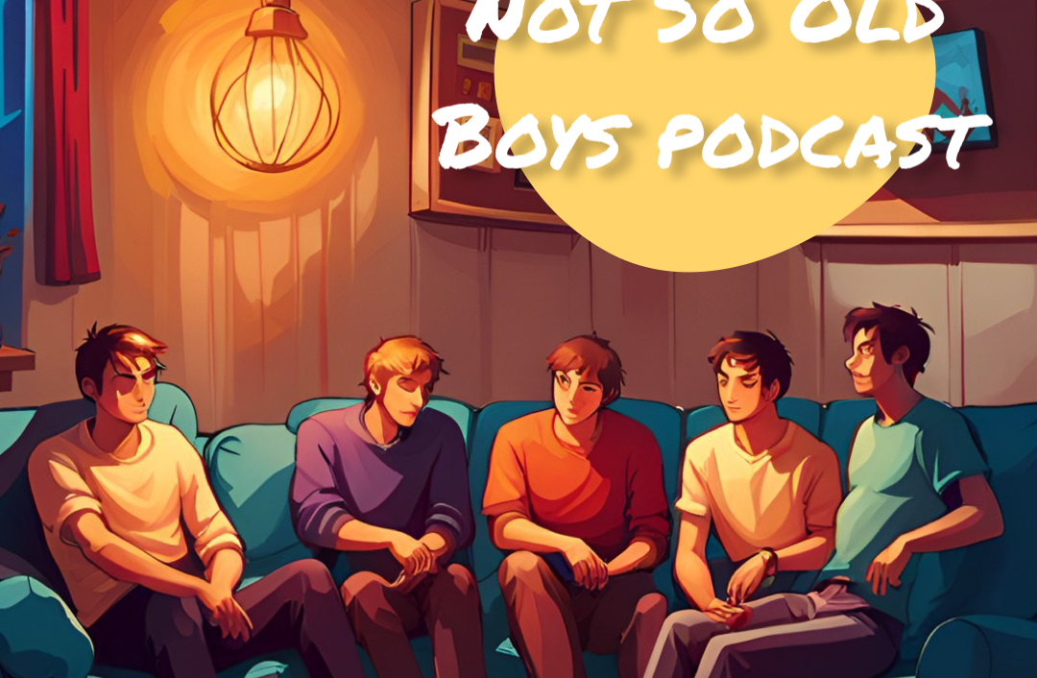
Not So Old Boys
Kicking taboo out of the game
After meeting through football and becoming a close knit group of friends.
They decided to launch a podcast to discuss taboo topics and just let the world know what it's like to play on Saturday football.
Follow the adventures of the Old Wilsonians Football Club through this Podcast and on Instagram.
Available on popular streaming platforms

Slide 14
Results
 | Vs | Score | Scorers
OWFC 1Xi | Bank of England | 4-2 | Farmer, Wright, Jeeven, Sitch
OWFC 2Xi | Orpington Town | 13-0 | Buddle-Smith 3, Sutherland 3, Forbes 2, Fitzgerald, Mansfield, Shelton, Binstead, Bogaard
OWFC 3Xi | Sinjuns Grammar | 0-5
OWFC 4Xi | Meadonians | 5-0 | Matt McDowell, Dan Whetton, Jack Burniston, Alex Duncan, OG
OWFC 5Xi | Postponed
OWFC 6Xi | Civil Service | 1-0 | Jordan Richards
OWFC 7Xi | Sedcopians | 4-8 | Curtis 3, OG.
OWFC Vets | Putney Old Boys | 3-5 | Andy Free, James Karamath, Andy Fox
OWFC SuperVets | No Game
A round up of all this week's results and scorers for the weekend of 11th October 2025.

Slide 15
The 1s welcomed Bank Of England to Hayes, OW's closest challengers in last season's title win and who also came into the game off the back of 2 wins from 2 in the league. The 1st were rocking the white change strip with the ever prepared James supplying the matching ankle tape. Professionalism personified.
Were BoE's minds in the right headspace with tough inflationary decisions looming ahead of the November budget? Were OWs tactical back-to-back 1st round cup exits going to pay dividend? Time will tell on a glorious, sunny autumn afternoon.
The 1s started well, dominating possession and stringing short, sharp passes together, with Sitch, Henry and Farmer looking threatening and the midfield trio paying close attention to BoE's infamous Podgy Pirlo. However, it was Bank who struck first, with a tame effort finding the back of the net after an uncharacteristic mix up between James and Kaya. 1-0. Not to be deterred, OWs continued to play well and were rewarded with an equaliser after Jeeven pivoted and found Farmer who slotted the ball home, 1-1. A 2nd for the home side subsequently followed, a Jeeven corner found Tree who nudged it on to James at the far post who headed it back across to an open Wright to nod home. A late, rare foray into OWs half saw Bank come closer to equalising, only to be denied by the crossbar. OWs took a well-deserved 2-1 lead into HT.
HT break began with Kirby laying down the law with a justified dad-like speech to ease off the Ref. Expertly delivered might I add, reaping the rewards of 45mins rehearsing on the bench. Discussions followed revolving around the sentiment that despite the lead, the 1s had multiple gears in the locker and it was time to kill the game.
A request to kill the game was called for and duly delivered with the next 25mins representing the 1s best passage of play all season. The third for OWs came from a Kirby ball into the box which was flicked on by Farmer to a late arriving Jeeven to rifle one into the bottom corner with his left foot. The jubilant onlookers did not have to wait long for a 4th, Henry flicking one onto the fox in the box, Sitch, who expertly lobbed the keeper from 10 yards out to round off an excellent display leading the line. The final quarter of the game became stretched as legs tired on a sun kissed Hayes. Bank did manage to pull one back late on but proved to be nothing more than a consolation. Full time, 4-2.
3 from 3 in the league for the 1s, the title charge well and truly has commenced. Roll on West Wickham next week. UT1s
MotM: O Sitch

Slide 16
OWFC 2s 13 v 0 Orpington Town 2s
Old Wilsonian 2s arrived nice and early at fortress Hayes for a 1.30 kick off, if only the referee had read his emails correctly..... Early pints were off the cards.
The local cup often brings a tasty derby, but Orpington Town 2s turned up & we had little to go on bar their poor league form (which tier that league sits in, who knows?).
OW 2s moved the ball quickly from the off & we soon found ourselves exploiting the wide spaces with Ryan & George shifting us left to right. It was down the right side we found success to begin with as a cross from QUASHIE found BUDDLE-SMITH at the back post who tapped it home into a fairly open goal. Very soon after that an almost carbon copy opportunity landed at FORBE's feet who similarly buried his chance at the first time of asking. The oppo were lacking organisation and to begin with we were ruthless in breaking them down, drawing them in and moving the ball through a defense that was offering little resistance. BUDDLE-SMITH lashes one into the roof of the net after some good work from AMRANE, linking up with Marley & Billy on our right flank. FORBES scored again before the half time whistle, can't remember how it happened but he ended up 1v1 with the keeper, I think AMRANE played a through ball.
Our focus shifted to ensuring we continued doing the right things and avoiding the inevitable nonsense a thrashing can bring. Unfortunately Orpington showed little bite and willing to fight back, although their effort can't really be faulted - the sides were unmatched on the day.
The second half began much the same way the first did, a bombardment from OWs eventually ended with the ball finding a marauding run from MANSFIELD who crossed the ball to the back post & BUDDLE-SMITH completed his hat trick with his first ever header. Nils was causing carnage up front, stretching the game, pushing Orpington further and further back. BUDDLE-SMITH whipped in an almost perfect corner, which reached an almost surprised SUTHERLAND flicked past the keeper under little pressure. After further pressure, the ball found SUTHERLAND yet again, who rifled his chance into the top corner of the net - I think it was a BOGAARD assist but can't be sure. FITZGERALD also scored at some point and I can already imagine he'll be annoyed I can't remember it so we'll await his response in the group chat.
At 9 nil, with the game in the balance, MANSFIELD picked the ball up, put his head down and drove into box drawing a reckless foul from Orpington's left backz penalty awarded. Local cup runs are an extremely important part of the season & thankfully SHELTON was on the pitch and willing to step up given the extreme pressure. With a large crowd gathering he slotted his penalty in the bottom left corner.
At this point SUTHERLAND was shooting on site, the Scotsman chasing his first ever hat trick. One of these shots landed at the feet of BOGAARD who calmly slotted home for his first goal of the season. At this point Orpington 2s we're justifiably fed up and their defense was receiving little support from the remaining players - it was time to cash in for OW 2s. From a BINFIELD corner, the ball richoted a couple of times before landing at the feet of SUTHERLAND who poked the ball home, completing his hat trick. The ball found MANSFIELD on the corner of the box who calmly slotted home for his first goal of the season. BINFIELD may well be as annoyed as FITZGERALD as I have it noted down here that he scored as well but I cannot for the life of me remember how it happened. A resounding win for OW 2s who remain unbeaten for the season & turn their head to another cup game on the 18th.
Squad: W. Humprhies, B. Mansfield, J.Shelton, J.Fitzgerald, F.Fisher-Sullivan, K. Page, R.Amrane, G.Catton, J.Binfield, J.Buddle-Smith, C.Sutherland (C), M.Quashie, S.Forbes, N.Bogaard
Scorers: Sutherland (3), Buddle-Smith (3), Forbes (2), Bogaard, Mansfield, Shelton, Binfield, Fitzgerald

Slide 17
OW 4s 5-0 Old Meadonians
The conditions were perfect for an OW classic, with the team waking up to a beautiful Saturday morning, all except McDonkwell who was still asleep. Clearly not ready for captaincy, the seasoned veteran Toby knew he had to step up and lead the warmup on his big return!
Whatever stretches he chose clearly worked as the boys came flying out of the blocks. A dry bobbly Hawesdown invited some rugby style hoof tactics. Although not fitting with the 4s new on-the-ground football philosophy, today it proved very effective with the front line really making it stick.
After begging to join the 4s at the end of season dinner, we told Akinfenwa that he wouldn’t start over our new hold up striker Jack Burns. Fair to say we made the right decision, with the big man opening the scoring 10 minutes into the game!
In typical 4s fashion the levels dropped after the goal, with Meadonians enjoying some of the ball. Despite this the defence held firm with our goal never being threatened. Perhaps it was this, or that he’d destroyed his vape because he thought there were flies inside 🤔, Lucas looked incredibly bored today.
Coming in at half time 1-0 up the boys received some mixed advice. Matt insisting players keep the ball and play backwards if needed, followed by Toby shouting “just get the ball fucking forward!” Either way this confusion didn’t translate on the pitch with the 4s dominating from the restart, quickly going 2-0 up. An impressive Atty-style air kick from Matt perfectly lobbed the defender to Alex’s feet, with the classy midfielder confidently finishing into the bottom corner.
The goals just then kept on coming. After giving the keeper some fitness practice (he needed it) with his previous efforts, Matt got a birthday goal with a nice effort from outside the box. 3-0 and the 4s were cruising.
4-0 came only a few minutes later. Not sure who to award this goal to with Whetton claiming the deflection off Alex’s long range effort. Happy to give it to Louis if it means he’ll stop shooting from the halfway line!
The 4s were really enjoying themselves at this point. Under pressure from Djed Pence, Arnold managed to kick the ball into his own face 🤣! After taking a moment to laugh, the team decided to turn it into a sweeping attacking move. Burns beating a few men before slipping it through to Whetton (who made number 18 consider never playing football again) to smash it in for 5-0!
Meady Meadonians convincingly put to the sword. Still unbeaten. Still on for everything this season. Up the fucking 4s!

Slide 18
Civil Service 7’s v Old Wilsonians 6’s
After a nice run of home fixtures, we made our way to Chiswick to play a Civil Service team that haven’t had the best start to their season. This filled the boys with confidence and determination to extend our unbeaten streak to three games and potentially go top of the table. All to play for!
During our warmup, we all noticed Civil had a slightly smaller pitch than usual and agreed on doing long balls over the top to test their defence and hopefully put them under pressure straight away. We kicked off and it was clear to see from the opening 10 minutes that we were the better side. Knocking it about comfortably and hitting the channels with long balls over the top.
All three attackers – Stridey, Jordan and James K were putting in a massive shift and chasing everything. Civil were under pressure and we had multiple chances, one of which was a lovely curled shot from Jordan which was destined for the back of the net… until a Civil defender came out of nowhere and produced a bit of magical defending with a goal line clearance which ricocheted off the cross bar and out for a corner. 20 minutes gone and it’s looking very positive from the 6’s.
Around the 30 minute mark, we had a corner which was whipped in nicely by Darin but unfortunately wasn’t met with a 6’s head and was booted out. This landed at the feet of a Civil attacker on the half way line who produced a speedy counterattack and was very quickly one on one with our keeper Sam. Sam made himself big and with half of the 6’s marauding towards him, we did enough to put the Civil attacker off and his shot goes miles wild. A huge let off and a massive wake up call.
Stridey unfortunately injures his hamstring and has to come off in the first half. James K goes up top and an eager Caiden comes on raring to go on the left wing.
We continue to create more chances but we’re just lacking the finishing touch. The ref blows his whistle and it’s half time. 0-0. We all gathered around quickly and had a positive team talk – complimenting each other on some of the chances we’re creating but not being afraid to express how we feel about the areas on which we can improve as a team and individually. Darin comes off for a breather as he’s worked incredibly hard and not stopped running. Vish steps into CM and Connor comes on at LB. The boys know we need to step it up in the second half. Game on!
The second half starts and the 6’s are out flying as the ball gets passed to Joe from kick off and he pings up top, which is met by James K who controls it nicely, plays it to Caiden on the wing who drives forward with pace but gets tackled and it goes out for a throw. Positive start and this energy was here to stay.
More of the same story, chances are being created but we’re just not finishing them. 60 mins gone and Henzo is replaced by Liam. Darin comes back on and replaces Vish.
5 mins later we get a corner. Darin delivers another great ball and it’s headered out by a Civil defender which lands at Joe’s feet. He takes a touch, shoots and watches as it heads towards the bottom right corner but the keeper makes a brilliant save and pushes it out for another corner. Darin again with a great delivery into the box but this time it’s headered out to Cal who’s on the right side of the box. He takes a touch, looks up and pings it back across the box which finds Jordan with his back against the goal holding off his defender. He takes a touch, quickly turns his body and in the same motion smashes the ball into the back of the net. 0-1 to the 6’s, come on!!
We finally made a breakthrough and want to keep this lead. 70 mins gone and Saj comes on at LB, which sees Cal come off at CM and Connor step into that role. James K comes off and Jordan goes to striker. Joe B comes on at right wing. Lots of subs with fresh legs ready to see this game out and bring home the three points.
You could see how much this meant to each person on the team, as every challenge was loudly celebrated, every ball was being chased and each attack was met with roars from the 6’s not just on the pitch but on the sidelines. We wanted this.
This became the narrative for the rest of the game and we comfortably saw the game out for a 0-1 victory!! Cheers erupted, we shook hands with the oppo and then celebrated together off the pitch. We’re now sitting top of the table and are unbeaten in three games. Next week we’re against Southbank in the junior novets cup. A game we really want to win! UT6’S!!

Slide 19
Match Report: Old Wilsonian 7th XI 4 – Old Sedcopian 4th XI 8
Venue: Hawesdown
Date: Saturday
A big thank you to Merv Nicholas, who stepped in between the sticks after the 5th XI match was cancelled — a true clubman!
This was another topsy-turvy encounter where Old Wilsonians were never ahead, despite battling hard throughout. The game swung wildly: 0–1, 1–1, 1–3, 3–2, 5–2 by halftime — a scoreline that tells its own chaotic story.
The bouncy pitch at Hawesdown and the low autumn sun played into Sedcopians’ hands, and their strong forward line consistently caused problems for the Wilsonian defence.
Our first goal came from a Jack Curtis corner, flicked in by a Sedcopian defender for an own goal. Jack then coolly converted a penalty to bring us back to 2–3, and we looked back in the game. However, two late first-half goals from Sedcopians meant we went into the break trailing 5–2 and facing a mountain to climb.
We started the second half brightly in a new 4-4-2 formation, but again struggled to contain Sedcopians’ attacking threat. Jack Curtis then produced two thunderbolts to complete his hat trick, giving us hope once more.
Unfortunately, injuries began to take their toll — the ever-youthful Bruce Graham limped off with a hamstring issue, and Ash Phakey followed with a groin injury. Sedcopians capitalised, adding two more goals to seal the win.
There were first starts for Clayton D’Souza and Alex Forbes, both showing promise. Adam Phillips impressed in midfield, and Jack Larkman put in a much improved performance.
Man of the Match: Jack Curtis — for his hat trick and all-round contribution.
Looking Ahead:
We need to focus on playing more football to feet and cutting down on the long forty-yard balls. The commitment and spirit remain strong — onwards and upwards!

Slide 20
Vets 2 Old Blues 0
Starting the new season on the hallowed turf of Hayes. Pitches not looking great but that wasn't going to stop our sexy football.
1st half
Rubbish! Only Karamath hitting the bar livened things up. Luckily they were as bad as us.
2nd half
Slightly less rubbish but still pretty rubbish. Got in loads of goalscoring positions but on most occasions tamely passed back to the keeper. With 5 to go a cross shot by Andy Fox was tapped in at the far post by Karamath and the right on full time Oli Beatson shanked a cross into the top corner.
Positives
Paton didn't pull a hamstring
Debuts for 1s treble winners Tom Weber McCartney and Oli Beatson
Their centre midfielder
We won
Negatives
Many!
Anyway unbeaten and no goals conceded. If we keep that up we will do ok!
Chesney Jennings, Dan Kent, James Paton, Doug Smart, Tom Weber McCartney, Jamie Parkinson, Andy Free, Gary Bonsels, Jon Howe, Andy Fox, James Karamath, Ruben Pillai, Oli Beatson

Slide 21
Match Report: Old Wilsonians SuperVets vs South London Arts Network – “For Kirk, For All of Us”
There are football matches that live in the memory for their drama, their goals, or their glorious incompetence. Then there are matches that mean something more — something that stretches far beyond the white lines of a muddy pitch. This one was that kind of game.
Played in honour of Kirk Benjamin, whose loss still echoes through the Old Wilsonians family, this was the first of two commemorative matches celebrating his life — and shining a light on the quiet, too-often-hidden struggles behind men’s smiles. Kirk’s passing became the catalyst for Men of the Hill, a charity that’s changing how we talk about mental health. Their motto — “Removing the mental from men’s health” — isn’t just clever wordplay; it’s a mission to turn conversations into lifelines.
And so, under a grey Kent sky, the Old Wilsonians SuperVets lined up against their old friends and occasional tormentors from the South London Arts Network, led by the irrepressible Kate Mason, who brought both class and culture to the touchline.
The OWs set up in a traditional 4-4-2, which is to say a shape both reassuringly solid and immediately forgotten once the whistle blew. Up top were Nelmesy and Kev Fowler, each chasing that elusive first goal of the season — one with determination, the other, as it turned out, with a certain artistic flair for missing.
Midfield was marshalled by Stoney and Popey, elegant and industrious in equal measure, flanked by Si “The Wand” Elliott (the nickname, we’re assured, refers to his foot) and Malcolm Smart, the smoothest scalp since Fabien Barthez. Behind them, Doug Smart, Nibbles, Chris “Father of VAR” Lovelock, and Simon Kershaw formed a back line with experience, calm, and at least one man wondering why his knees had opted out of the warm-up.
The early exchanges were lively. The Arts Network pressed high, looking sharp, while the VEO camera, kindly supplied by Stoney, captured every twist, turn, and Fowler near-miss for forensic review later.
Momentum began to shift with the introduction of Kenners, along with newcomers Ed Rugby and Mark McGowan, whose energy immediately lifted the side. Kenners charged down the flank like a man possessed — and from one of those surges, Doug Smart arrived late and finished coolly to make it 1–0.
Then came Kenners’ own moment — a darting run, a neat finish, and 2–0 before half-time. Confidence flowed. The half-time oranges tasted like belief (and possibly gin).

Slide 22
The second half began as all good halves do — with Mark McGovern deciding to rewrite the club’s highlight reel. Picking the ball up on the left, he danced past two defenders, shifted it onto his right, and unleashed an absolute thunderbolt from 30 yards. The ball screamed into the top corner as if powered by celestial energy — 3–0, and probably the best goal ever scored in SuperVets history.
The final flourish came courtesy of Popey, finishing neatly after Si Elliott set him up. It was 4–0, and that was that. A scoreline to savour — and one mercifully unrecorded act of footballing sabotage from Kev Fowler, who somehow managed to miss an open goal from beneath the bar, slicing the ball gently into the arms of a keeper who’d already given up.
Referee Gilly kept things fair, calm, and largely coherent — no small feat given the number of sliding tackles performed in slow motion.
Man of the Match went to Stoney, whose lungs apparently operate on a different evolutionary model, and who — perhaps even more impressively — provided the VEO camera for posterity.
Thanks to Pikey for arranging the fixture, Alex Stuart for his raffle donation, and Graham Nicholls for buying every bottle of wine going.
But most of all, thanks to everyone who turned up — to play, to support, to remember, and to talk. Because the match, for all its goals and laughter, was about something much greater: the power of connection, of showing up for one another, and of keeping the conversation alive.
For Kirk. For every man who thinks he’s alone. For Men of the Hill — the team that never stops playing.
1. Steve Donnelly 2. Malcolm Smart 3. Chris Lovelock 4. Mark Pope 5. Simon Kershaw 6. Nick Billing 7. Ed Rugby 8. Simon Elliott 9. Kevin Fowler 10. Chris Kennedy 11. Dave Nelmes 12. Doug Forbes 13. Adam Stone 14. Mark McGowan 15. Doug Smart
Doug Forbes

Slide 23
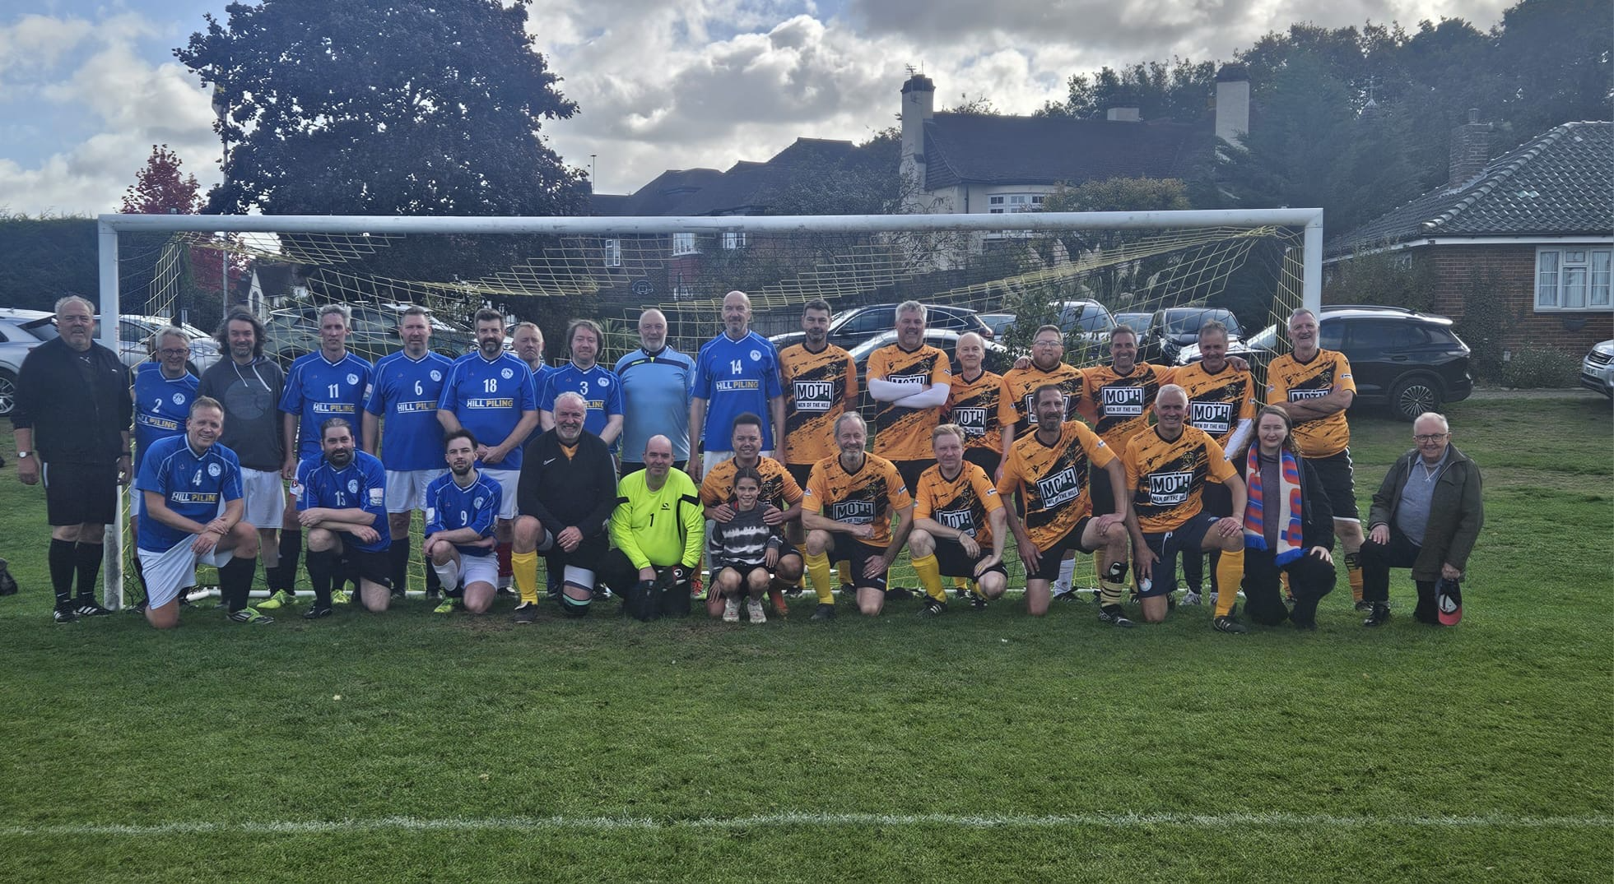
OWFC SuperVets vs Art Network , 4-0

Slide 24
Fixtures
 | Vs | Competition | Location
OWFC 1Xi | West Wickham | SAL | Home
OWFC 2Xi | Fulham Compton | OBC | Home
OWFC 3Xi | Carshalton | SALC | Home
OWFC 4Xi | Fulham Compton | SAL | Away
OWFC 5Xi | Suttonians | SAL | Away
OWFC 6Xi | South Bank | AFA | Away
OWFC 7Xi | South Bank | AFA | Home
OWFC Vets | Morden Expats | SAL | Home
OWFC SuperVets | No Game
A look at all the upcoming fixtures for the weekend of 18th October 2025 throughout the club (Week 6)

Slide 25
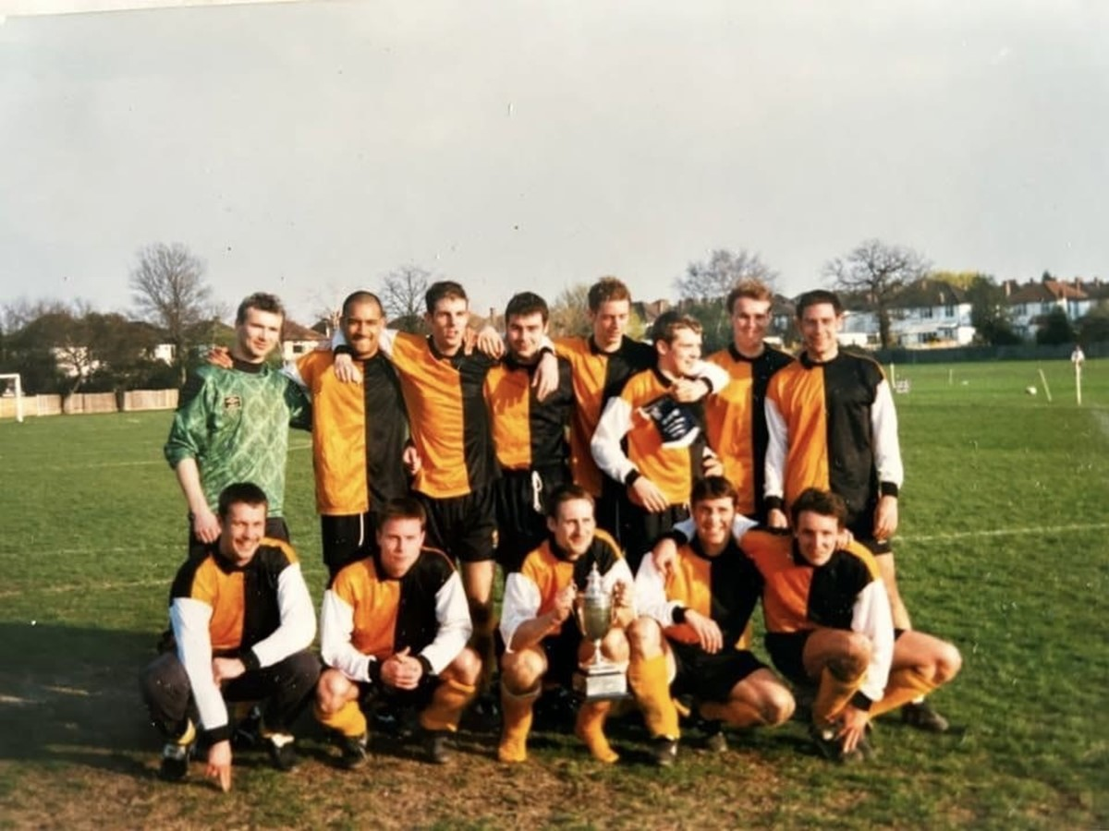
ALL OUR YESTERDAYS - 25 YEARS AGO
Classified Resuts , October 7th 2000
1st Xl | 0 | Old Ignatians | 2
2nd Xl | 6 | Lloyds TSB | 1 | Karamath 3, Smart.D. 2, Trout
Glyn Old Boys | 2 | 3rd Xl | 2 | Quinton, Simms
Qyeen Mary College | 0 | 4th Xl | 3 | Pilgrim.M, McBride, Paton
Old Suttonians | 2 | 7th Xl | 5 | Hodgess 3, Dry 2

Slide 26
NEW SEASON, NEW LEADERSHIP, FINE START Old Suttonians 2 7th Xl 5
The sevens started a new season at a wet Northey Avenue under the new leadership of Alan McGrath and I’m sure he was more than satified with this performance.
Both teams started slowly but, when we began passing the ball, our domination became apparent. The first goal, however, was route one when a Steve Skelton ‘hoof’ fell kindly for WILL HODGESS, who took the ball on and blasted it into the top corner.
Our second was nothing other than sensational, when a passing move the length of the pitch was finished by RICHARD DRY, sliding in at the near post.
The second half saw us increase our lead with another WILL HODGESS long range effort, but we allowed Suttonians back into the game when slack marking gave an attacker a one-on-one on goal, but the game was always going to be ours and when RICHARD DRY pounced on a ‘keeper error, we should have gone on and scored for fun.
Dave Warboys, in particular, had a very fine game and, on any other day, could have helped himself to a hatfull. Suttonians did pull another one back and WILL HODGESS completed his hat-trick when his speculatve 40 yard free-kick caught the ‘keeper, oppistion, team mates – and himself!– by surprise. If he tells you he did it on purpose, then do not believe him! Neville Spencer
Only one match report was submitted 25 years ago, so it is down to:
Discipline
With the season a mere three weeks old, we chalked up our fourth booking on Saturday. Whilst making allowances for “extenuating circumstancse,” this is far too many and, with fines at £7 a time, you surely have better ways of spending your money.
Bar staff required
The Bar Manager is still looking for bar staff, the main shifts that need to be covered being Friday and Saturday evenings, although there is also the opportunity for week day working. Interested parties should contact George Wing at the Club.
Teas
A tea person is required for Saturday afternoons to feed a hoard of muddy footballers, short on patience and often displaying a limited knowledge of the English language – the footballers, that is, not the tea person. Put like that, it does not sound a very attractive proposition but someone has to do it!, Again, those interested should speak to George Wing.

Slide 27
ROOM FOR IMPROVEMENT Old Hamptonians 2 2nd Xl 0
The first 20 minutes of this game saw some uninspiring attacking from both sides competently dealt with by both defences. Hamptonians took the lead when their unmarked striker gave Steve Donnelly, the 2’s keeper, no chance, after which we came under sustained pressure for ten minutes, culminating in the home side’s second goal from a player whose off the ball run had not been thwarted.
In the second half there was some improvement in the quality of football played, but neither goal-keeper was seriously tested. From a spectator’s point of view, the 2nd Xl looked like a side capable of playing much better than they did in this game. There were flashes of individual skill from a number of players but the team as a whole rarely looked in control of the game and a 0-2 defeat was a fair reflection of the opposition on the day, but the Hamptonian side looked far from unbeatable and a reversal of this result is a realistic aim for the return fixture. Tony Reid
Donnelly Roe Goddard Scriminger Saraga Pullen Burgess Hickey Smart.M Holmes ‘Jamie’

Slide 28
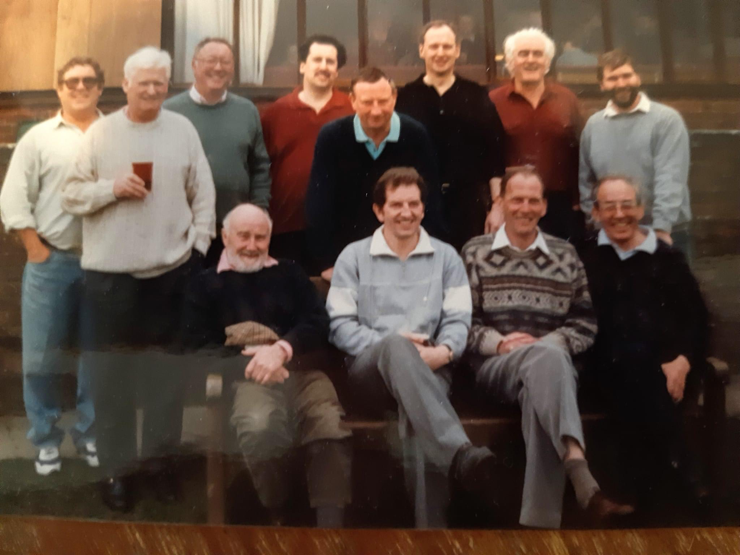
ALL OUR YESTERDAYS - 50 YEARS AGO
Classified Results
Classified Results, October 11th 1975
1st Xl | 4 | Old Libertians | 2 | (Jim) Matthews (2), (John) Matthews, Montgomery
2nd Xl | 1 | Old Parmiterians | 5 | Cowell.C
Old Actonians | 3 | 3rd Xl | 1 | Howell
Brent | 1 | 4th Xl | 1 | Houghton
5th Xl | 1 | Southgate County | 1 | Hough
Old Monovians | 7 | 6th Xl | 0
7th Xl | 0 | Coutts Bank | 1
Palace | 3 | Grimsby | 0 | Evans, Kemp, Swindlehurst

Slide 30


BIG IMAGE
Old Wilsonians Club Shop

Slide 31










A massive thank you to all your support with our grass roots football
OWFC Sponsors
Cladish Sports Wallington

Slide 32
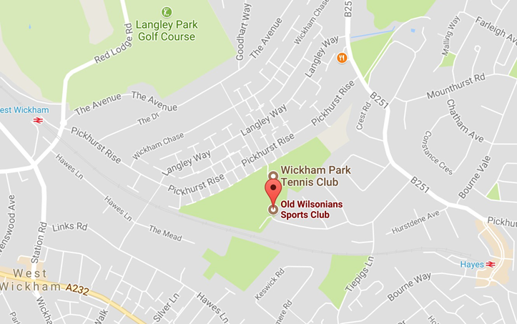
Where to find us?
Where to find us
Old Wilsonian Hayes Hill
Hayes
Kent, BR2 7HT
Tel: 020 8462 2600
Closest Rail Station – Hayes (Kent) 14 min walk
Social Media
Website: www.oldwilsonians.com
Twitter: @oldwilsonians Facebook: OWFC Facebook Group (Members Only)
Newsletter Contribution - All contributions to the newsletter should reach Mark Pope by 6:00 pm on a Monday evening – the earlier the better. Please send any articles/match reports/images to markypope@hotmail.com or via Whatsapp on 07788 780486

Slide 33
Club Contacts
 | Name | Email Address
OWFC Xi | Josh Eves Sam Wright | evesjoshua@gmail.com sam_wright_29@hotmail.co.uk
OWFC 2Xi | Calum Sutherland Danny Mansfield | dtmansfield15@gmail.cpm
OWFC 3Xi | Steven Peares / Rory Sweeney | stevenpeares@gmail.com
OWFC 4Xi | Max Exelby / Luke Saitch / Matt McDowell | exelbymax@gmail.com / luke@saitch.com / mathhewmcd2000@gmail.com
OWFC 5Xi | Chris Dyki | chris@inhousephotography.co.uk
OWFC 6Xi | Joe Kajdi Andrew Callam | joseph.edward@hotmail.com andrewcallam@hotmail.co.uk
OWFC 7Xi | Alex Forbes | alexforbes46@hotmail.co.uk
Vets Super Vets | Jamie Parkinson Doug Forbes | jamieparkinson@hotmail.co.uk doug.forbes@outlook.com
Selection Sec | Cejay Watson
Roll of Honour
RIP Life President: Mike Harris
Treasurer: President:
Stu Dunk
Chesney Jennings
Chairman: Dan Harris
Hon. Secretary: Jamie Parkinson
Club Captain: Sam James
Newsletter Contribution - All contributions to the newsletter should reach Mark Pope by 6:00 pm on a Monday evening – the earlier the better. Please send any articles/match reports/images to markypope@hotmail.com or via Whatsapp on 07788 780486

